Slide 1
Banking Dataset Case Study
August 2024
Kanishk Arvind Singh

Slide 2
About the case
The dataset captures detailed records of 45,211 customer interactions from a Portuguese bank's direct marketing campaigns conducted through phone calls between May 2008 and November 2010. The primary goal is to predict whether a customer will subscribe to a term deposit product. Information includes customer attributes (age, profession, marital status, education, financial product holdings), campaign details (contact method, timing, call duration, previous outcomes), and potentially external factors like interest rates. Analyzing this data aims to determine the overall conversion rate of the campaigns, identify the key customer and campaign characteristics driving subscription decisions, and potentially uncover temporal trends that might impact future marketing strategies.
www.reallyygreatsite.com

Slide 3
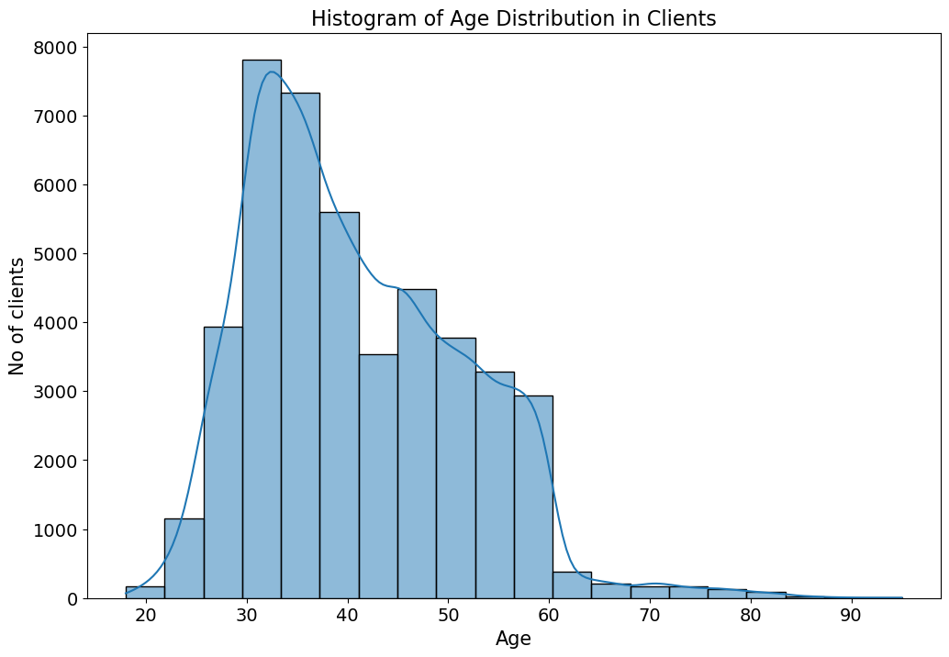
Distribution of age among clients
Findings:
1. 43% of the clients are between the age of 30 and 40
2. Clients above the age of 70 are classified as outliers (487 such entries)
3. The median age is 39 years

Slide 4
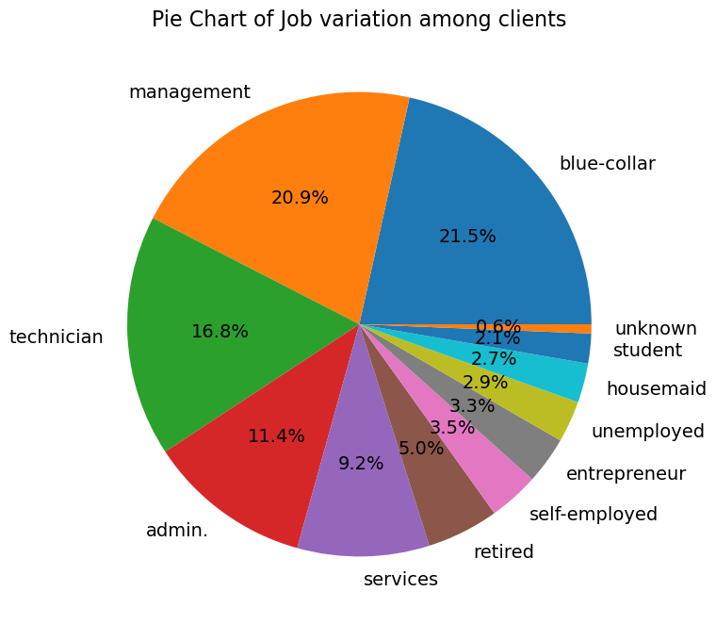
Job type variation among clients
Findings:
1.Majority of the clients(42.4%) have blue collar jobs or are in some management role.
2. Only 2.1% of the clients are students which is very less.
3. There are relatively fewer clients who are self-employed, entrepreneurs, unemployed, housemaids, and students.
4. The 'student' and 'unknown' categories have the smallest number of clients.
.

Slide 5
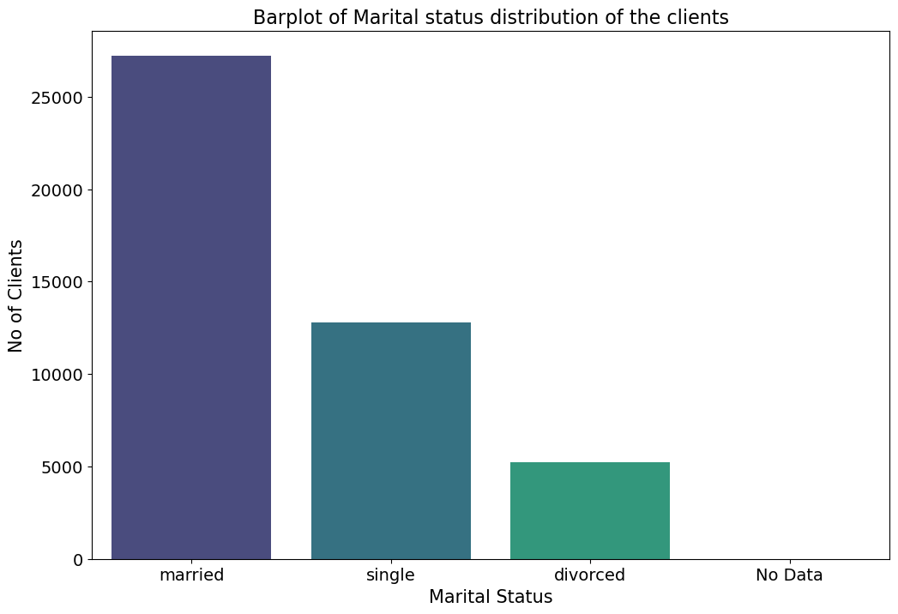
Findings:
Marital Status Distribution
Majority of the clients are Married.
Single clients are the next most common group but are less than half the number of married clients.
Divorced clients represent a smaller fraction compared to the married and single clients
There is a small category labeled "No Data", indicating that there are some clients for whom the marital status is not recorded.

Slide 6
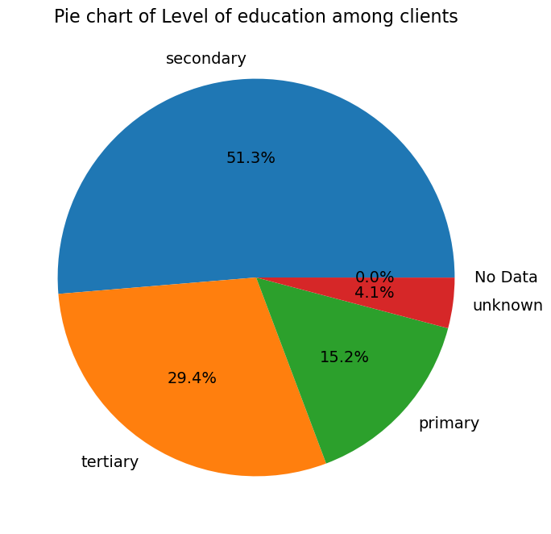
level of education among clients:
Findings:
1. Majority of the clients(51.3%) have completed their secondary education.
2. The next substantial group consists of clients with tertiary education, indicating a significant number of clients with higher education.
3. Clients with primary education form a smaller proportion compared to the other two educational levels.
4. There is a category of clients for whom the level of education is unknown.

Slide 7
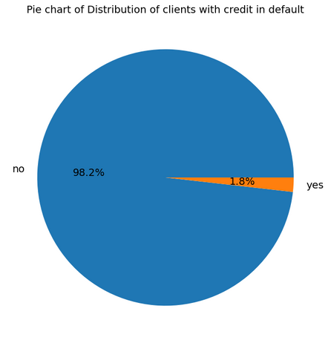
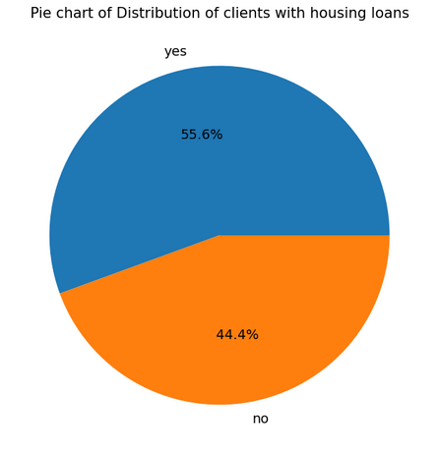
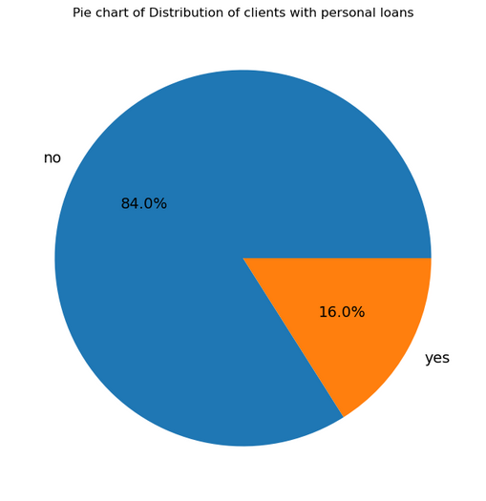
Clients with credit
Clients with housing loan
Clients with personal loans
Findings:
Findings:
Findings:
Only 1.8%(815) of the clients have credit in default
Majority of the clients (55.6%) have housing loans
Majority of the clients (84%) of the clients don't have any personal loans

Slide 8
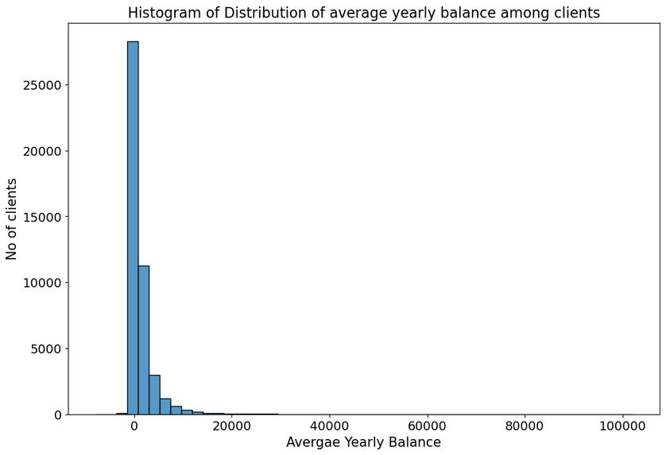
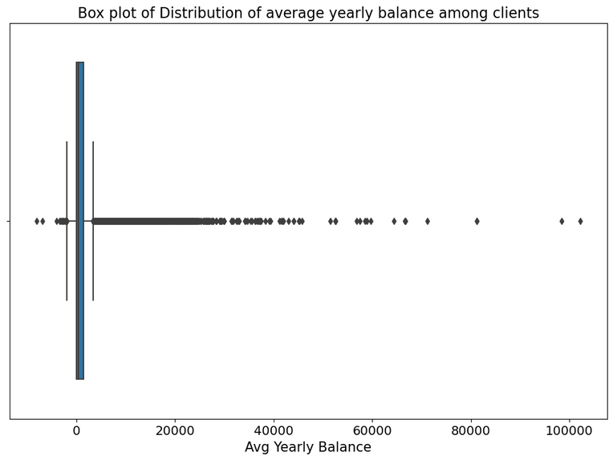
Average yearly Balance Distribution
Findings:
A large majority of clients have a relatively low average yearly balance, as indicated by the tall bar at the beginning of the histogram.
2. The frequency of clients decreases rapidly as the balance amount increases, suggesting that higher balances are much less common.
4. The distribution is right-skewed, with most clients clustered in the lower balance range and outliers with high balances.
3. There are very few clients with an average yearly balance above 20,000 euros, indicating that high balances are rare within this client base
5. Considering the shape of the distribution, the bank’s client base is likely comprised of individuals with modest means rather than high-net-worth individuals.

Slide 9
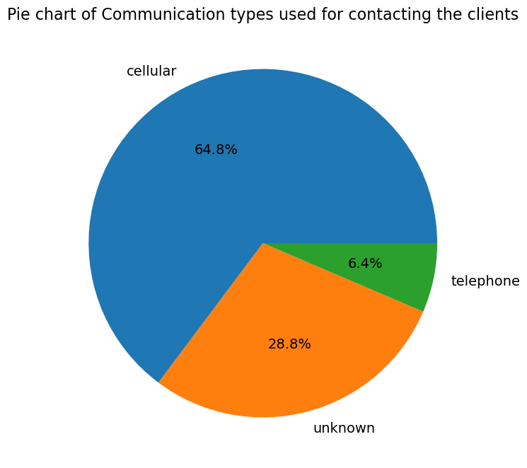
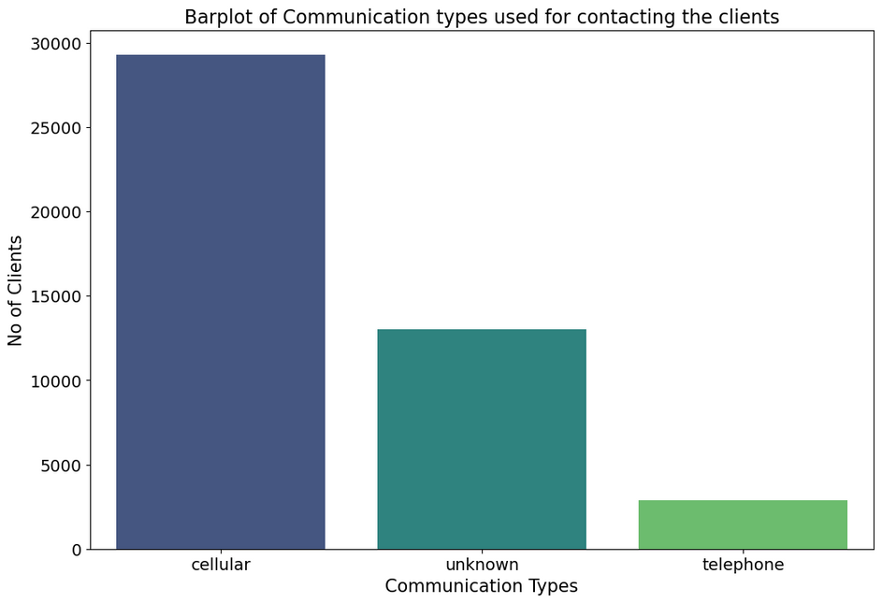
Communication types used during campaign
Findings:
1. 64.8 % pf the clients were contacted using a cellular medium.
2. only 6.4 % of the clients were contacted using telephone.
3. A very large percentage of the clients (28.8%) were contacted using unknown means.

Slide 10
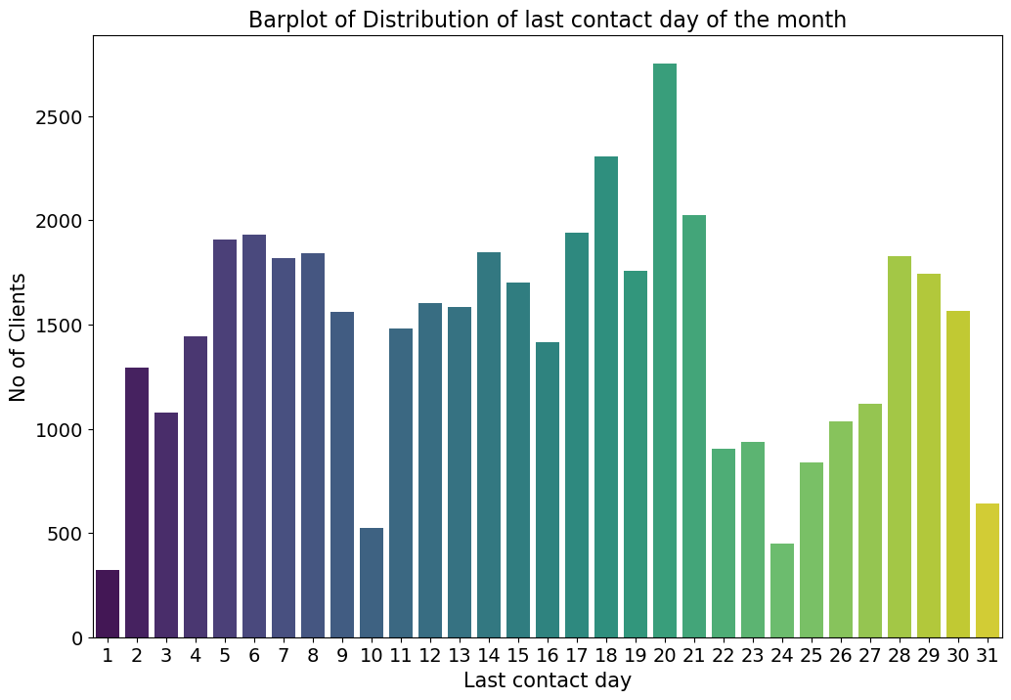
Last contact day of the month Distribution
Findings:
The distribution of last contact days is not uniform across the month.
There is a significant peak around the middle of the month, specifically on day 20, indicating a higher frequency of client contacts on that day.
The beginning and the end of the month show lower frequencies of contact.
Notably, the 31st has the lowest frequency, which could be due to fewer months having this date.

Slide 11
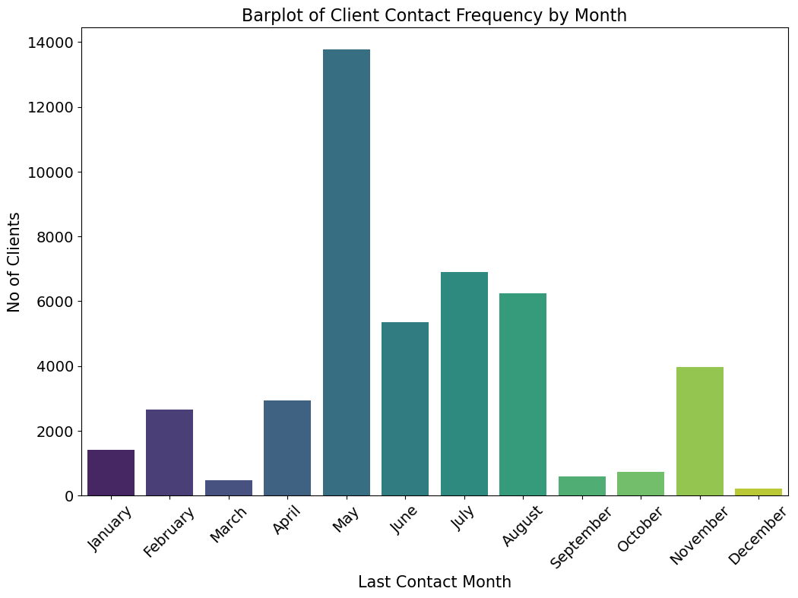
Findings:
Variation of last contact month among clients
The contact frequency is significantly higher in May than in any other month, suggesting that this is a peak period for the marketing campaign.
There is a significant peak around the middle of the month, specifically on day 20, indicating a higher frequency of client contacts on that day.
The months of June, July, August, and November show a moderate level of contact frequency.
Notably, the 31st has the lowest frequency, which could be due to fewer months having this date.

Slide 12
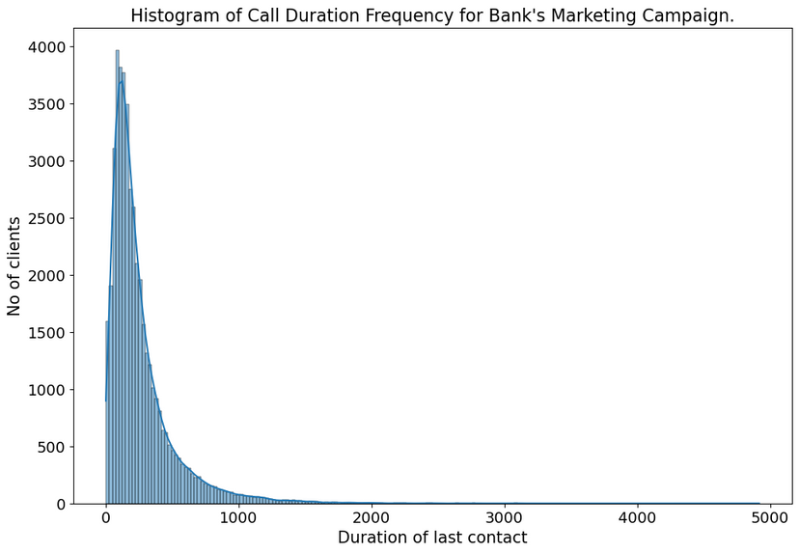
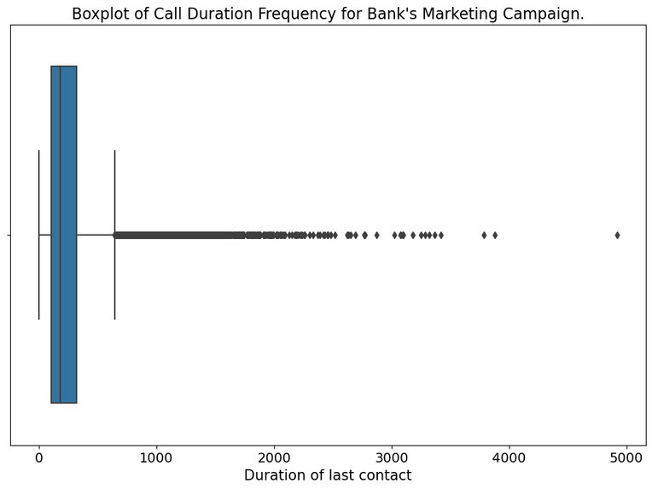
Last contact Duration Distribution
Findings:
1. The mean call duration is 258s.
2. The distribution is heavily right-skewed, indicating that most calls were relatively short, with a steep decrease in frequency as call duration increases.
4. Very few calls had a very long duration, which suggests that extended conversations were rare in this campaign.
3. There is a high frequency of very short calls, with the number of calls declining rapidly as the duration lengthens.
5. The vast majority of contacts were brief, possibly underlining the efficiency of the call center or a focus on quick interactions.
6. The pattern might indicate that the standard call was meant to be brief, with only specific circumstances leading to longer discussions.

Slide 13
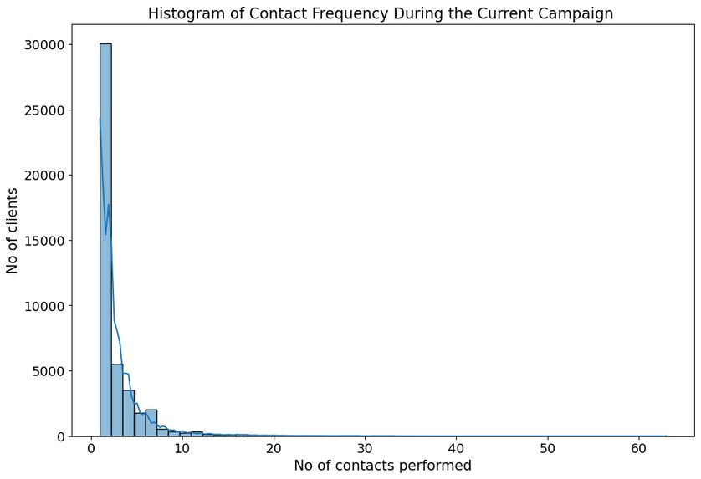
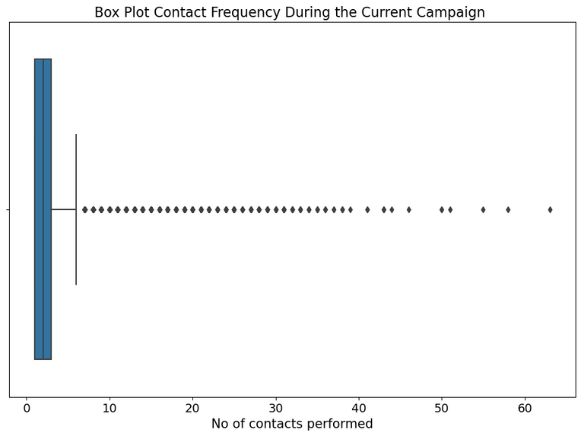
Contacts performed during campaign for each client
Findings:
1. The data is highly positively skewed.
2. The vast majority of clients were contacted a few times, with a sharp decrease in the number of clients as the number of contacts increases.
3. The highest proportion of clients(86.46%) received less than 5 contacts during the campaign.
5. The distribution of contacts is extremely skewed to the right, suggesting that the campaign strategy primarily focused on a lower number of contacts per client.
4. A very small number of clients were contacted more than 20 times, which indicates that such extensive contact is very rare.
6. There is a notable number of outliers where clients were contacted many more times than the median.

Slide 14
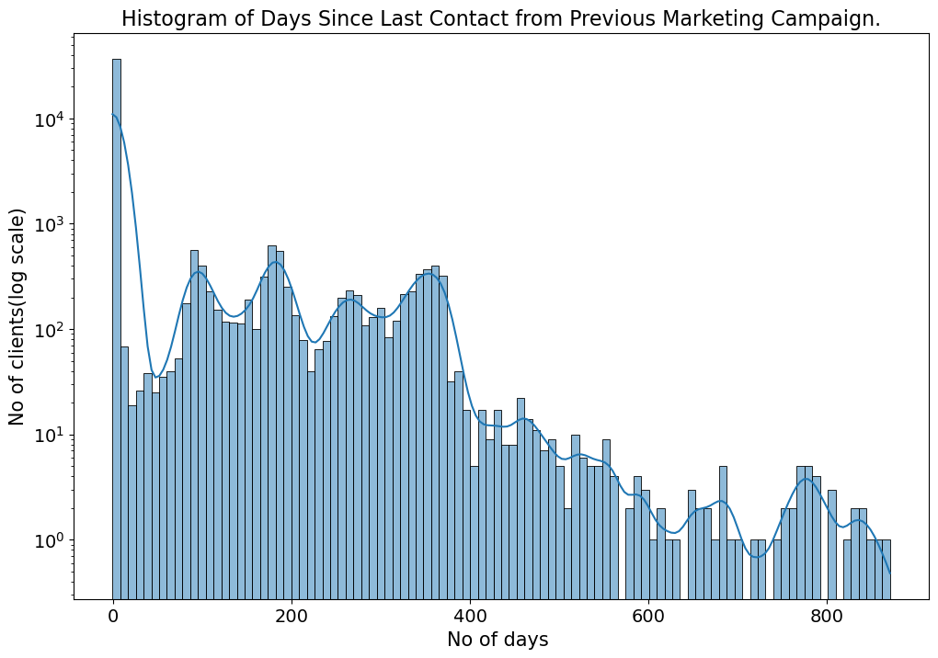
Findings:
No. of days since last contact from prev. campaign
1. Most of the clients(81.73%) have never been contacted before.
2. The data is highly positively skewed.
3. There are relatively few clients who have been contacted after a gap, with the number decreasing sharply as the number of days increases.
4. There is a very long tail to the distribution, indicating that while most recent contacts are quite recent, there are some clients who haven't been contacted for a very long time.
5. The presence of outliers indicates that there are exceptions where clients had not been contacted for a long period before the current campaign.
6. There is a sharp peak at or near zero, indicating that a significant number of clients were contacted recently or not at all since the previous campaign.
7. Overall, the distribution is skewed to the right, reinforcing the idea that most re-contacting efforts occur after a shorter interval or that many clients are new and have not been contacted before the current campaign.

Slide 15
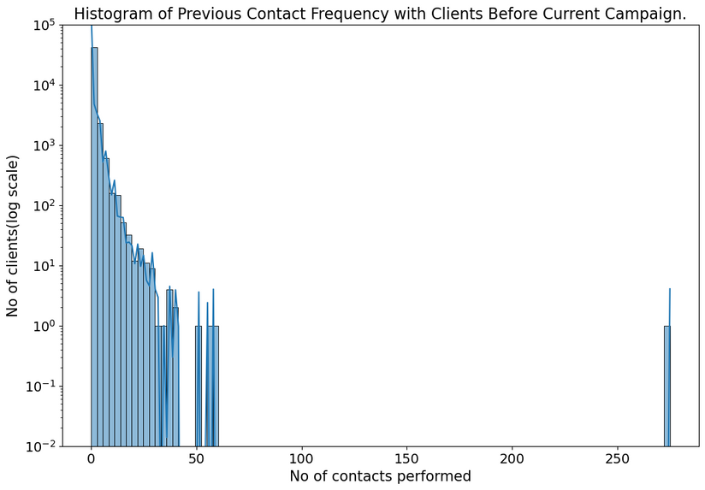
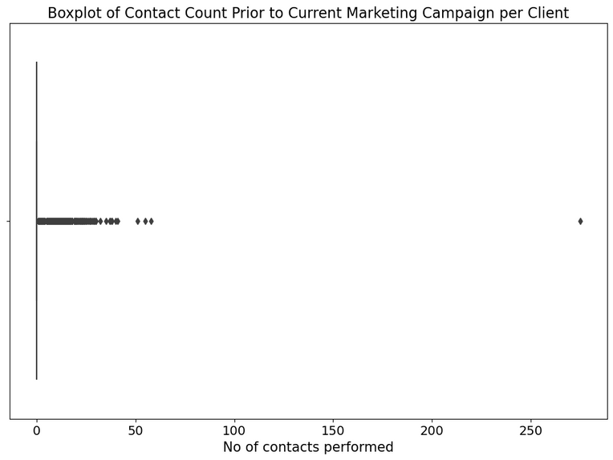
Contacts performed before the current campaign
Findings:
1. The data is highle positively skewed.
2. The overwhelming majority of clients(81.73%) had zero contacts before the current campaign, suggesting a large number of new engagements or a policy of minimal prior contact.
3. There is a steep drop-off in frequency as the number of previous contacts increases, indicating that repeated outreach to the same clients was relatively uncommon.
4. Very few clients had a high number of contacts, as evidenced by the long tail that extends to the right, which implies that only a select few clients were contacted repeatedly.
5. The distribution is highly right-skewed, meaning that the bank's contact strategy might be focused more on acquiring new clients or those with less prior interaction.
6. Overall, the bank’s outreach strategy likely prioritizes new engagements over repeated contacts with the same clients.
7. There are a significant number of outliers, implying that while most clients had minimal contact, a few had a much higher number of contacts.

Slide 16
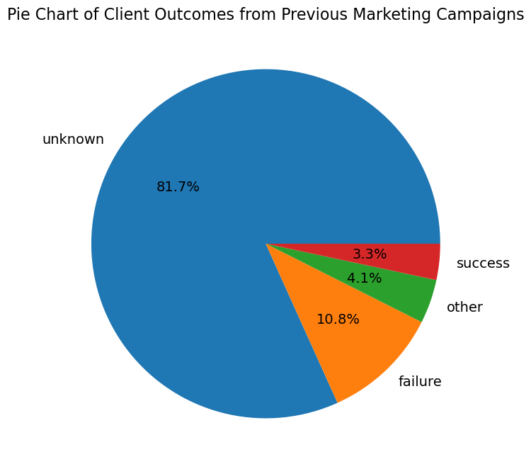
Outcome of previous campaigns:
Findings:
1. The vast majority of the previous campaign outcomes are unknown, which comprises 81.7% of the total, indicating a lack of data on past client engagement or response.
2. Only a small fraction of clients have a known outcome from previous campaigns, with 10.8% labeled as failures and 3.3% as successes.
3. An even smaller segment, 4.1%, is categorized as other, which might include outcomes that are neither clearly successful nor outright failures.
4. This distribution suggests that there is a significant opportunity for the bank to improve its tracking and analysis of campaign outcomes to better understand client behaviors and patterns.

Slide 17
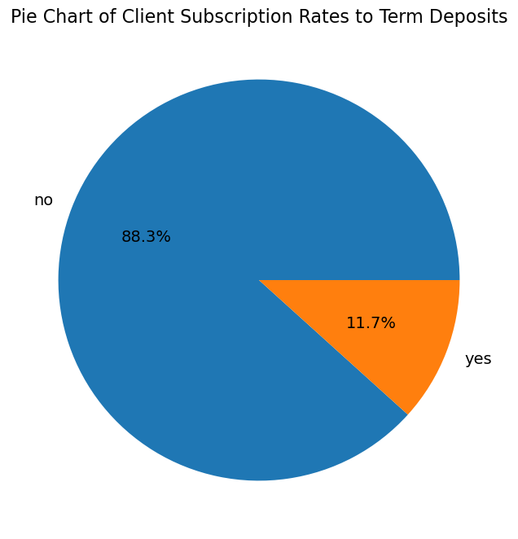
Clients who subscribed v/s who did not to term deposit
Findings:
1. A significant majority, 88.3%, of clients did not subscribe to a term deposit, indicating a relatively low conversion rate for the campaign.
2. The minority, 11.7%, represents the clients who did subscribe, highlighting the successful conversions.
3. The large disparity between subscribers and non-subscribers suggests room for improvement in targeting or product offering to increase the subscription rate.
4. Strategies to convert the large segment of non-subscribers could include personalized follow-ups, tailored financial products, or incentives.

Slide 18
Key Findings
Subscription rates for term deposits are strongly influenced by client age. Younger clients (18-30) are less likely to subscribe, while a steady increase is observed with age, notably peaking in the 60+ demographic.
Term deposit subscription rates vary significantly based on client occupation.Retirement and student status correlate with higher subscription rates, while blue-collar and entrepreneur occupations exhibit lower rates.
Education level appears to correlate with term deposit subscription rates. Clients with tertiary education demonstrate the highest rates, followed by those with secondary education. Clients with primary education have the lowest subscription rates.
Marital status significantly influences term deposit subscription rates. Single clients exhibit the highest rates, followed by divorced clients, while married clients have lower rates.
Client default history strongly correlates with term deposit subscription likelihood. Those with no defaults exhibit significantly higher subscription rates, while those with a history of default show much lower rates.

Slide 19
Clients with extremely low balances (<10000 euros) have and exceptionally low likelihood of subscribing to the term deposit.
Clients without existing personal loans demonstrate a significantly higher likelihood of subscribing to term deposits compared to those with loans
Clients without housing loans demonstrate a higher propensity to subscribe to term deposits compared to those with mortgages. This suggests that major financial commitments like housing loans may influence investment decisions.
Contacting clients via cellular phones results in the highest term deposit subscription rate, outperforming telephone contact and the "unknown" category.
Term deposit subscriptions exhibit significant variation across the year. March demonstrates the highest rates, while mid-year months (June/July) show lower rates, and an increasing trend is noted towards the year-end.

Slide 20
Thank You
August 2024

